Slide 1
NBAC TSC Slides 30 January 2025 Meeting

Slide 2
30 JAN 2025 NBAC TSC Agenda
1:00 NBAC Co-Chair Opening Remarks – Mr. Kamran Atri & Thomas Krul
Next PGB Meeting, today,30 Jan 2025, 2-4 PM
Microsoft Teams 30 January PGB meeting 2-4 PM EST.
Join the meeting now
Meeting ID: 993 967 584 930
Passcode: JTiu7a
Dial in by phone
+1 410-874-6749,,296683050# United States, Odenton
Find a local number
Phone conference ID: 296 683 050#
NBAC Issues Kanban Board: https://github.com/orgs/niemopen/projects/7/views/2
Motion to approve Paul Wormeli as NBAC Co-Chair – Steve Sullivan
1:10 NIEM Management Office (NMO) Update – Ms. Katherine Escobar
NIEMOpen NDR v6.0 PSD01 – simple majority vote - PGB notified of vote, 6 Jan 2025, vote conducted week of 20 Jan 2025 - APPROVED
NIEM Model v6.0 PS02 – special majority vote – PGB notified of vote, 27 Jan 2025, vote anticipated week of 10 Feb 2025
“Special Majority Vote” is a vote in which at least 2/3 (two thirds) of the eligible voters vote “yes” and no more than 1/4 (one fourth) of the eligible voters vote “no”. These numbers are based on the total number of eligible voters in the (PGB. Abstentions are not counted. For example, in a PGB in which there are 30 Voting Members, at least 20 Voting Members must vote “yes” for a motion to pass; but if 8 or more vote “no” then the motion fails. All Special Majority Votes must be conducted via electronic ballot by the OASIS OP Administrator.
1:20 NTAC Update – Dr. Scott Renner
1:30 Communications & Outreach NMO Sub-Committee update – Paul Wormeli
1:35 Community Updates - all
1:40 Questions/Final Remarks
Slides available at 30 January Minutes folder, NBAC Admin Repo
https://github.com/niemopen/nbac-admin/tree/main/nbac-meeting-minutes

Slide 3
Motion to Appoint Mr. Paul Wormeli as NBAC CO-CHAIR
The PGB Chair, Katherine Escobar nominated Paul Wormeli for appointment as a Co-Chair of the NBAC with associates Mr. Atri and Mr. Krul.
Maker: (NBAC- Mr. Steve Sullivan) I motion for unanimous consent to appoint Mr. Paul Wormeli as NBAC Co-Chair.
Is there a SECOND?
Any Objections ?
Resolution
Approve
Approve w/Comment
Table/Reject
Notes:
1. The member (Steve Sullivan) addresses the chair – “Mr. Chairman”
2. The chair recognizes the member – “The chair recognizes Steve Sullivan”
3. The member (Maker-Steve Sullivan) makes a motion – I motion the NBAC appoint Mr. Paul Wormeli as NBAC Co-Chair.
4. Another member seconds the motion – SECOND
5. Chair: “It is moved and seconded to adopt the motion.
6. The members debate the motion
7. Chair: Those in favor of adopting the motion to approve say ‘Aye.’ [pause] Those opposed, say ‘No.’”
8. Chair: Announce the result
If no objections
Chair: Without objection, approved

Slide 4
Announcements
PGB approved NIEMOpen NDR v6.0 PSD01
Submitted for Publication to OASIS Library
https://github.com/niemopen/niem-naming-design-rules
Preparing NIEM Model Version v6.0 PS02 for vote & publishing
Next steps
2 week notice to PGB of upcoming vote (complete)
Request ballot for Special Majority Vote (complete)
Vote 11-18 Feb 2025
: https://github.com/niemopen/niem-model/tree/2afcd93dc4061e825df8c2b3bf44557bbd4cb976

Slide 5
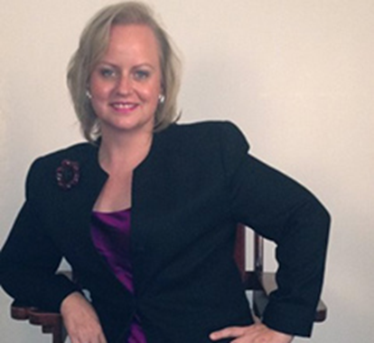
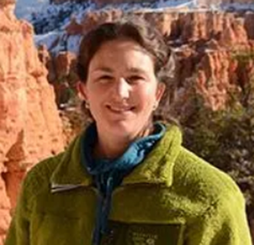
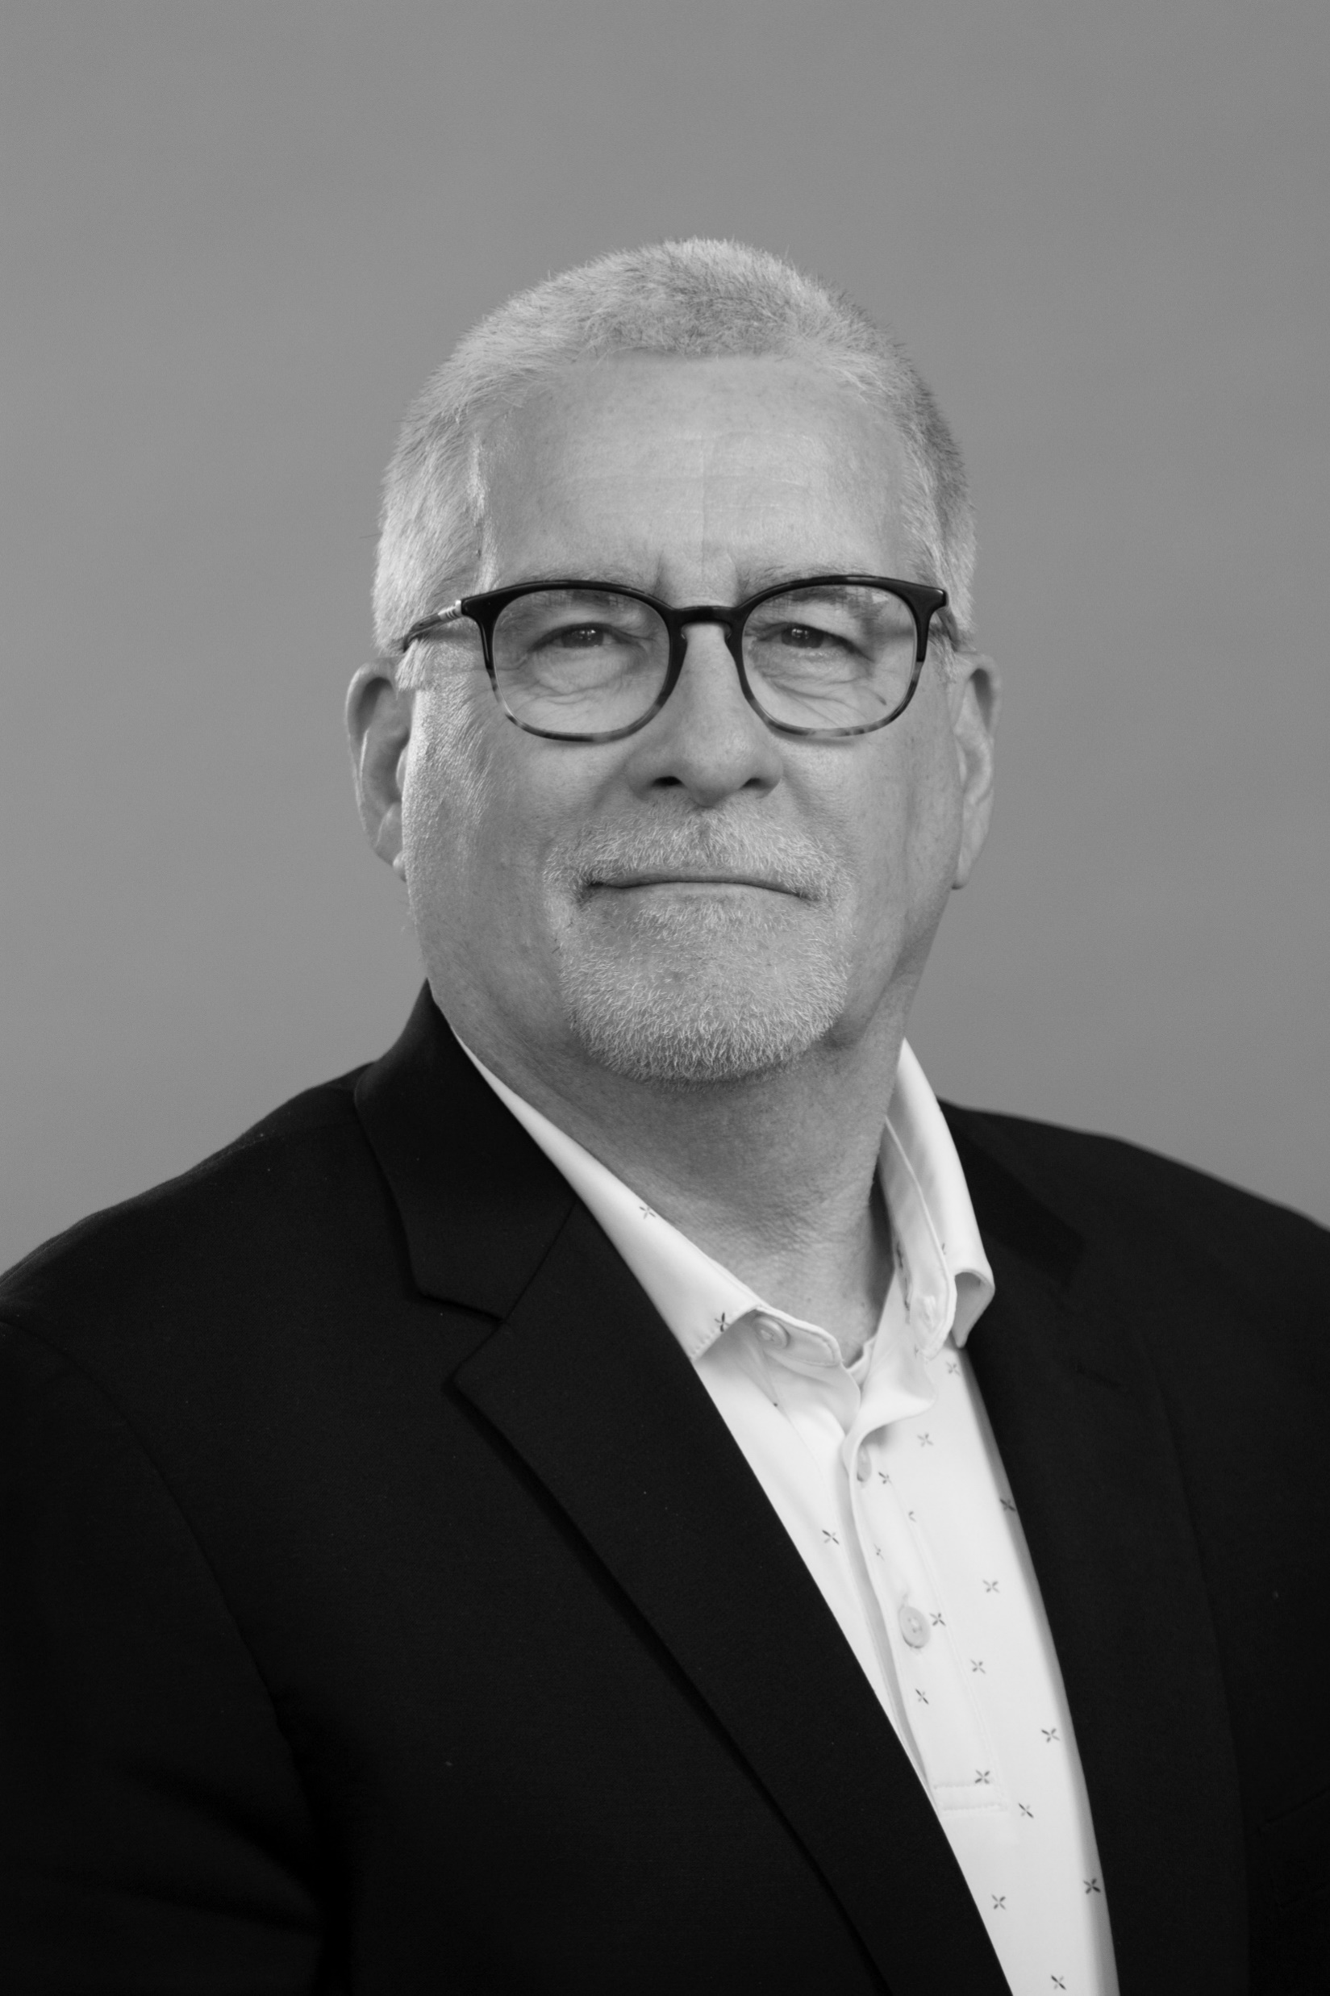
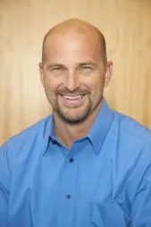
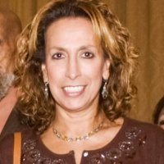
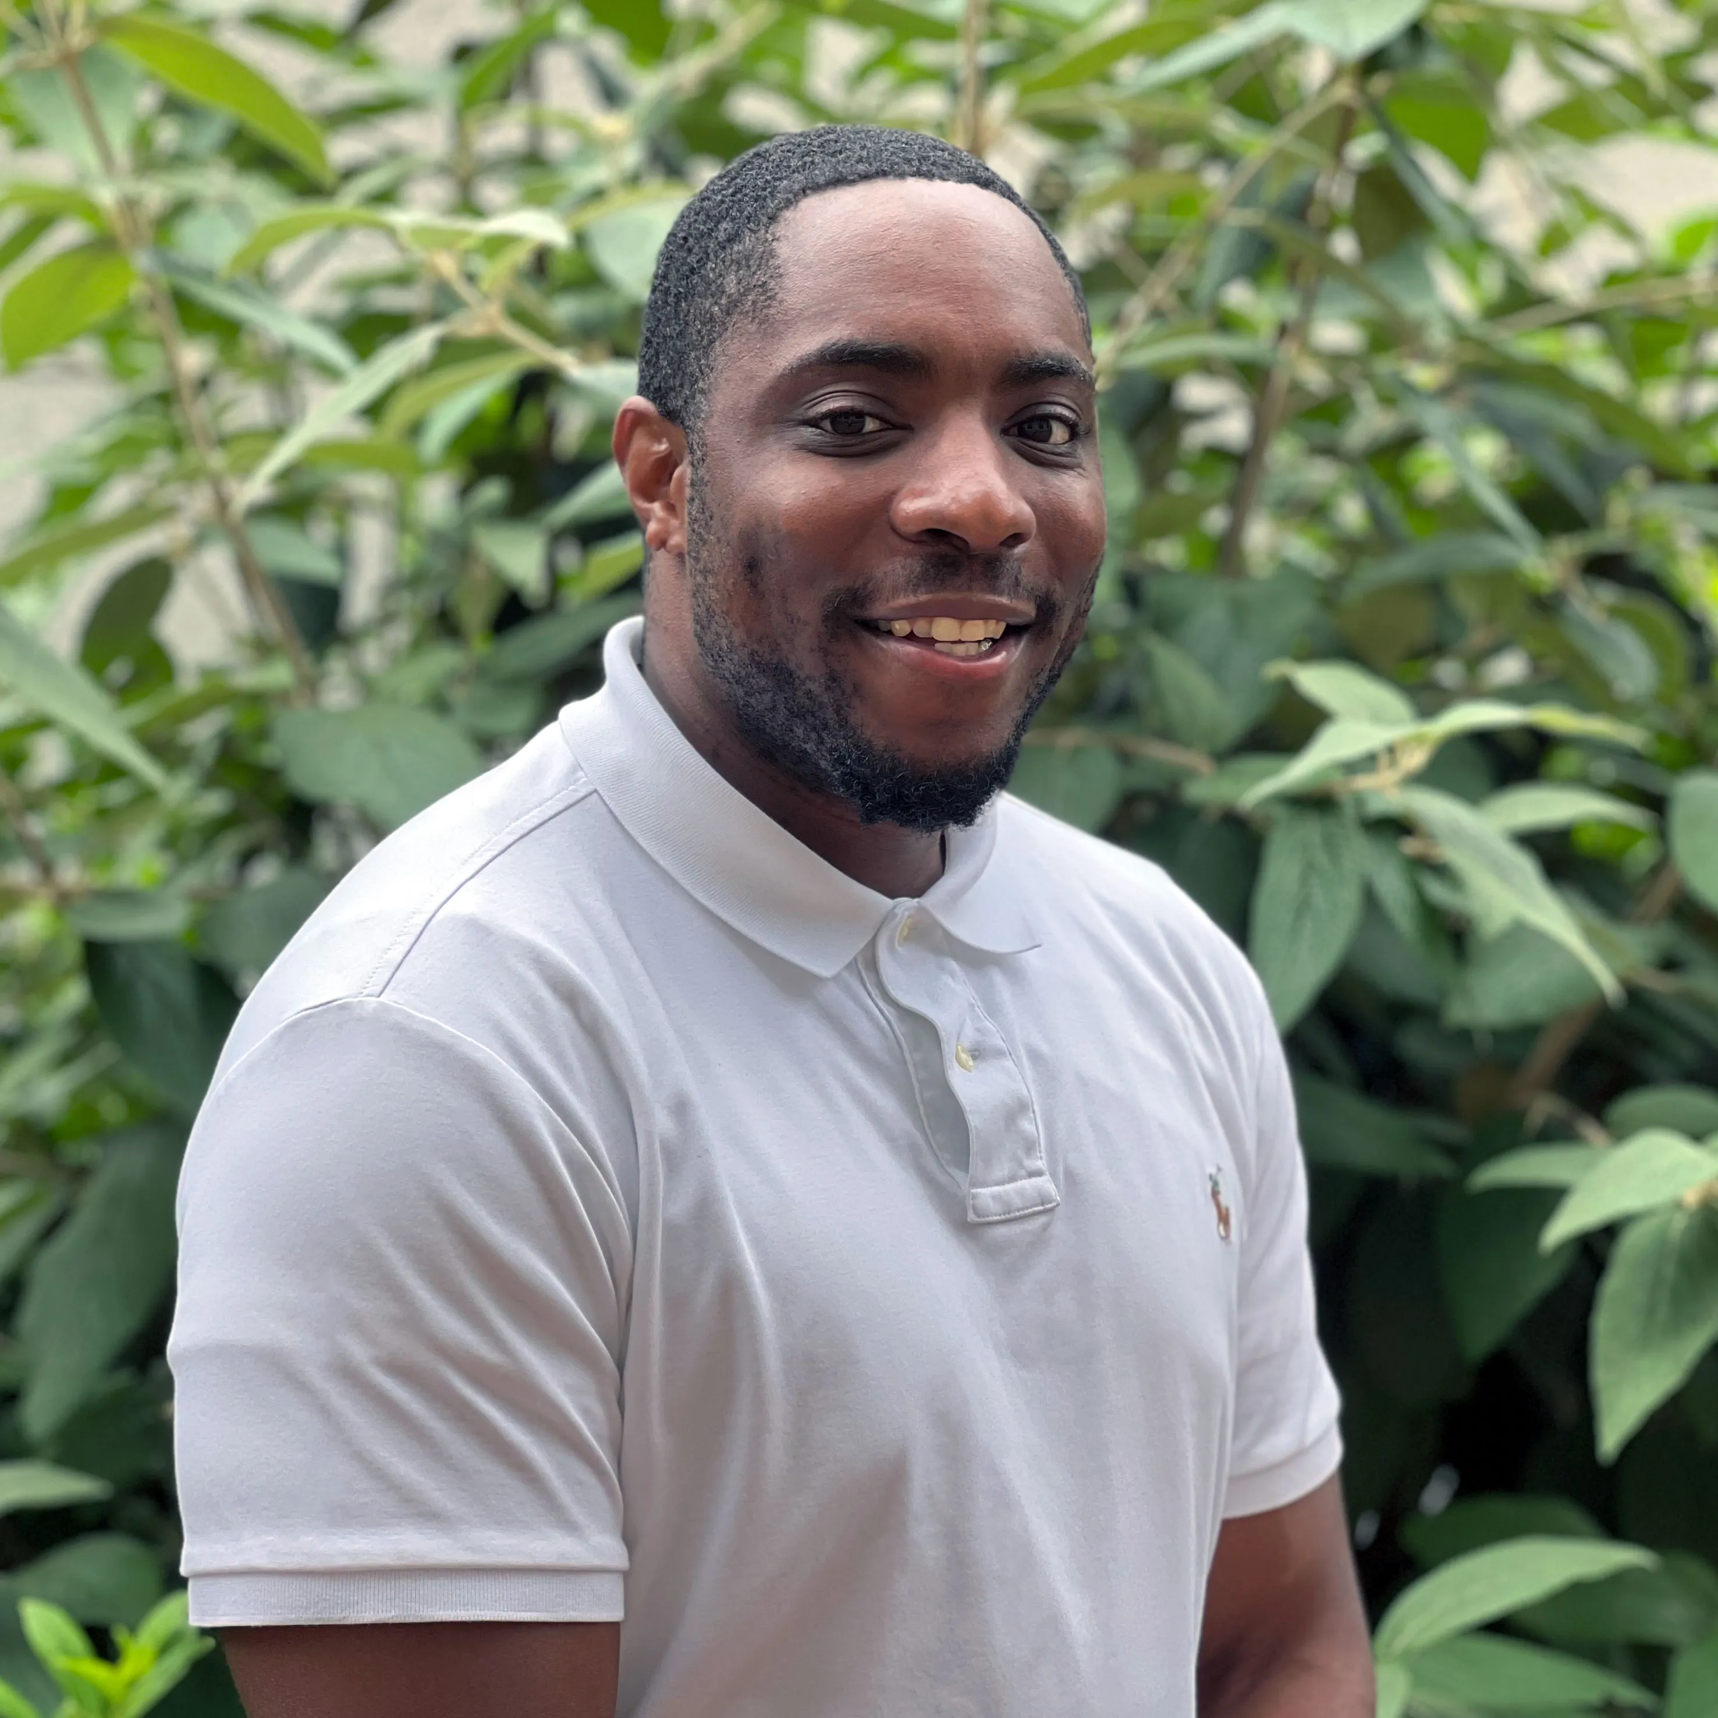
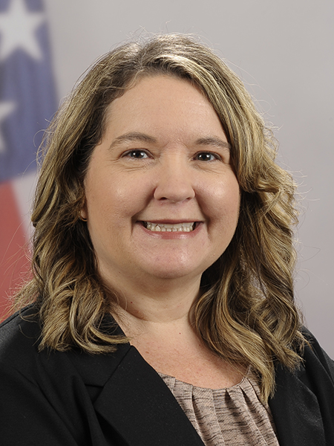
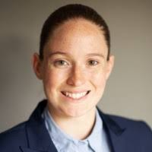
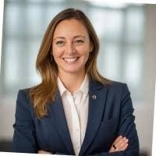
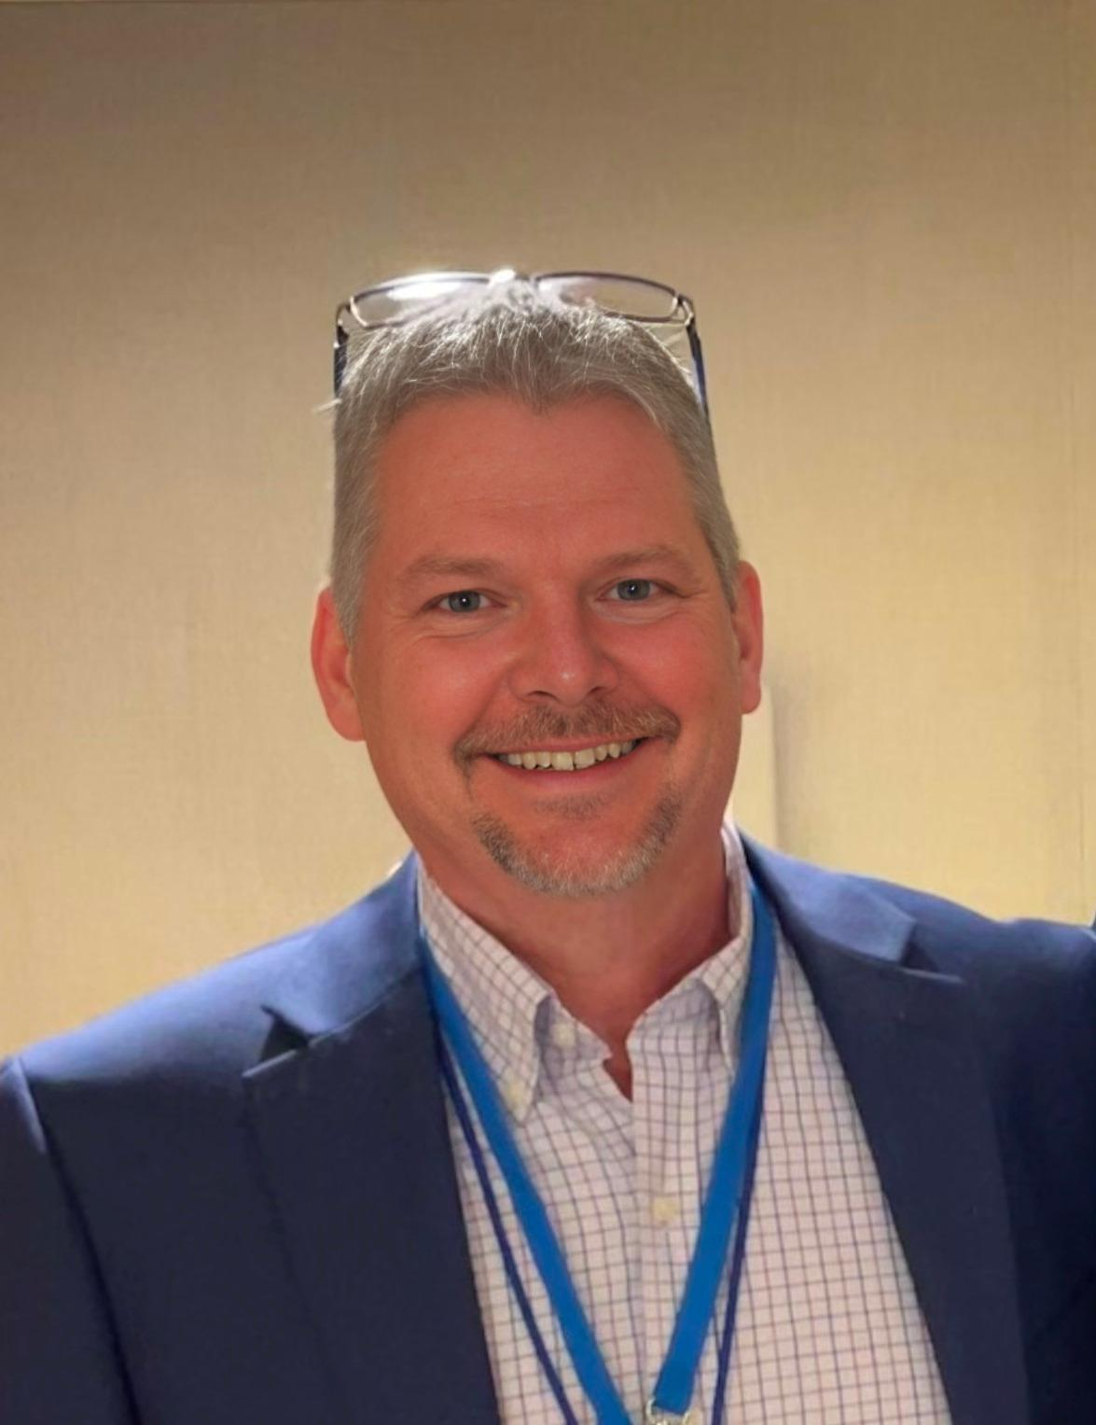
PGB APPOINTED VOTING MEMBERS
Ms. Katherine Escobar
PGB Chair
Deputy Division Chief, Data and Standards Division at Joint Staff J6 and NIEM Managing Director
Ms. Christina Bapst-Stump
Science and Technology Directorate, US Department of Homeland Security
Mr. Gary Egner
Director Business Development, Equivant
Mr. John Wandelt
Principal Research Scientist, Georgia Tech Research Institute
Ms. Maria Cardiellos
Executive Director
Integrated Justice Information Systems Institute
Mr. Payton Lamb
Data Engineer
Commonwealth of Virginia
Office of the secretary of Administration
Office of Data Governance and Analytics
Ms. April Mitchell
FBI It Specialist and Technical Lead of Data Standards in the Criminal Justice Information Services (CJIS) Division
Ms. Erin Partin
Data Scientist, Office of the Principal Deputy Director, National Institute of Justice (NIJ)
Ms. Erica Smith
Data Scientist, Unit Chief – Law Enforcement Incident-Based Statistics Unit, Bureau of Justice Statistics(BJS)
Mr. Tom Welch Director of Information Technology
OHIO HIDTA – Including Northern KY & Western PA
Notes:
Open Project Rules - OASIS Open (oasis-open.org)
5.1 Overall guidance for the Project is provided by its Project Governing Board (or PGB). The PGB is composed of one voting member from each Project Sponsor who elects to appoint a PGB member, and (a) if the PGB has one or more Technical Steering Committees, one voting expert representative from each TSC, elected or appointed by that TSC, or (b) otherwise, the PGB may appoint at least one and no more than two voting expert representatives from its community of contributors. The PGB may create additional non-voting PGB member seats for expert representatives to be elected by the TSC or appointed by the PGB. The PGB membership of all such members of any type is conditioned on satisfaction of the CLA requirement of Section 5.2. Voting status on the PGB may be affected by the provisions of Section 5.7.

Slide 6
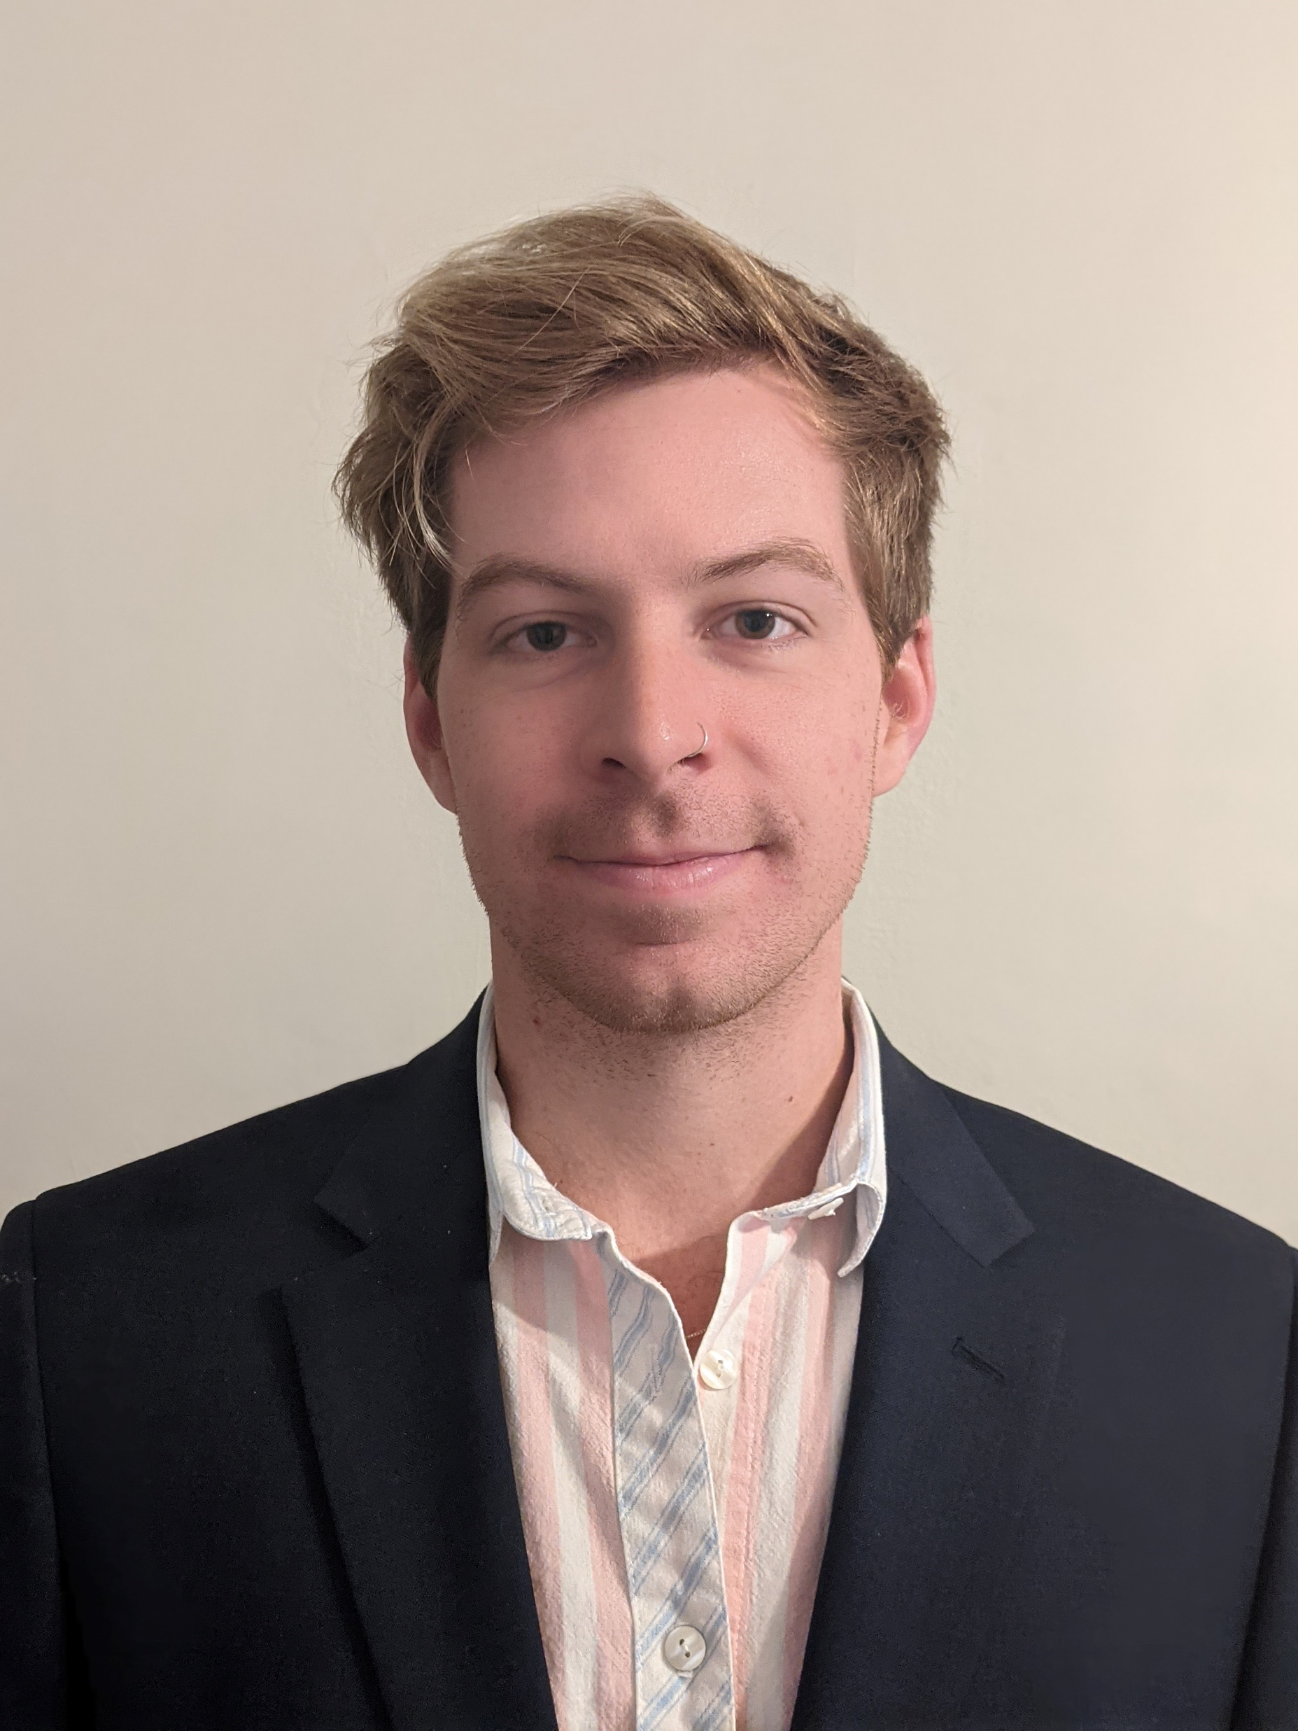
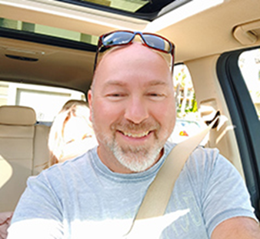
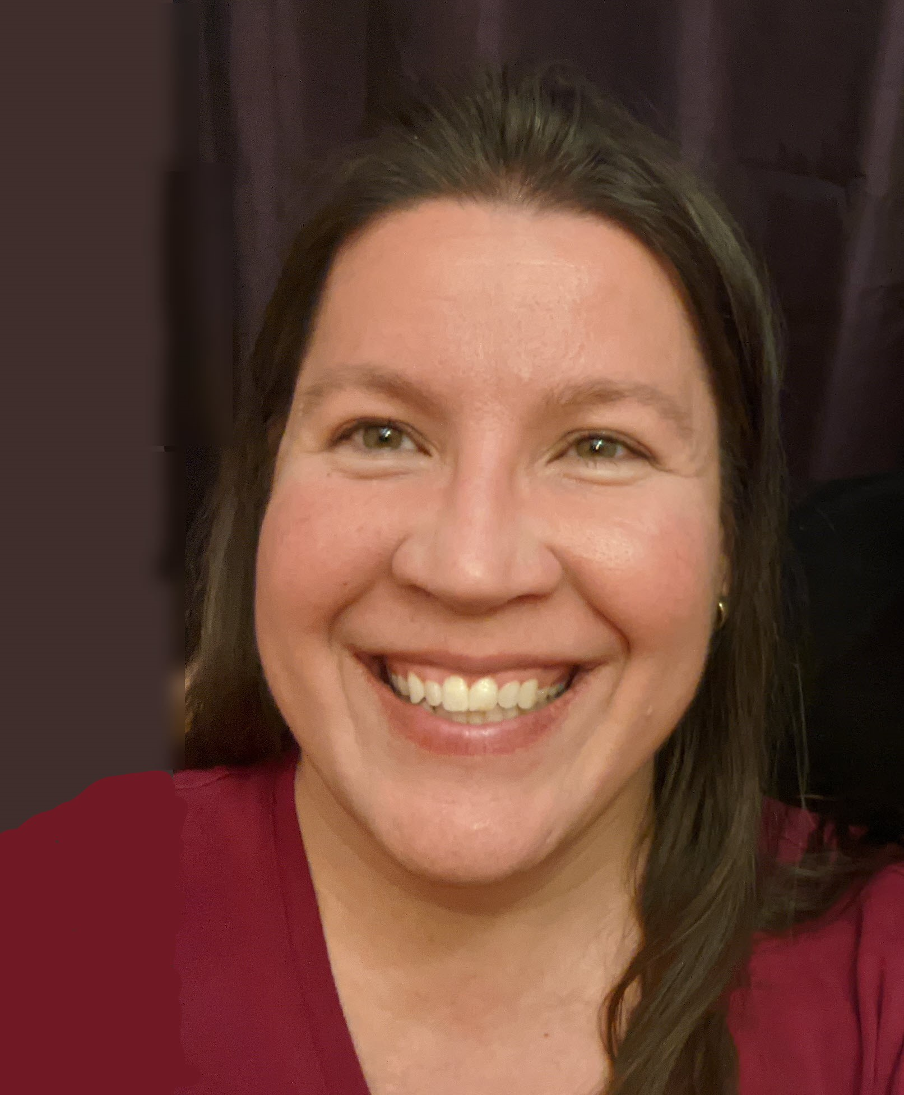
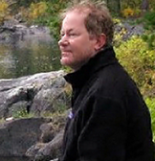
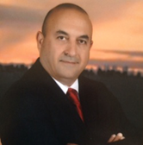
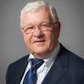
PGB EXPERT VOTING MEMBERS &
NON-VOTING MEMBERS
PGB EXPERT VOTING MEMBERS
Technical Steering Committees
PGB EXPERT NON-VOTING MEMBERS
Technical Steering Committees
Mr. Kamran Atri
Co-Chair, NIEM Business Architecture Committee TSC
Mr. Paul Wormeli
Co-Chair, NIEM Business Architecture Committee TSC
Mr. Brad Bolliger
Co-Chair, NIEM Technical Architecture Committee TSC
Mr. Thomas Krul
Co-Chair, NIEM Business Architecture Committee TSC
Ms. Darcy Staley
Co-Chair, NIEM Management Organization TSC
Dr. Scott Renner
Co-Chair, NIEM Technical Architecture Committee TSC
Notes:
Open Project Rules - OASIS Open (oasis-open.org)
5.1 Overall guidance for the Project is provided by its Project Governing Board (or PGB). The PGB is composed of one voting member from each Project Sponsor who elects to appoint a PGB member, and (a) if the PGB has one or more Technical Steering Committees, one voting expert representative from each TSC, elected or appointed by that TSC, or (b) otherwise, the PGB may appoint at least one and no more than two voting expert representatives from its community of contributors. The PGB may create additional non-voting PGB member seats for expert representatives to be elected by the TSC or appointed by the PGB. The PGB membership of all such members of any type is conditioned on satisfaction of the CLA requirement of Section 5.2. Voting status on the PGB may be affected by the provisions of Section 5.7.

Slide 7


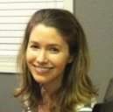
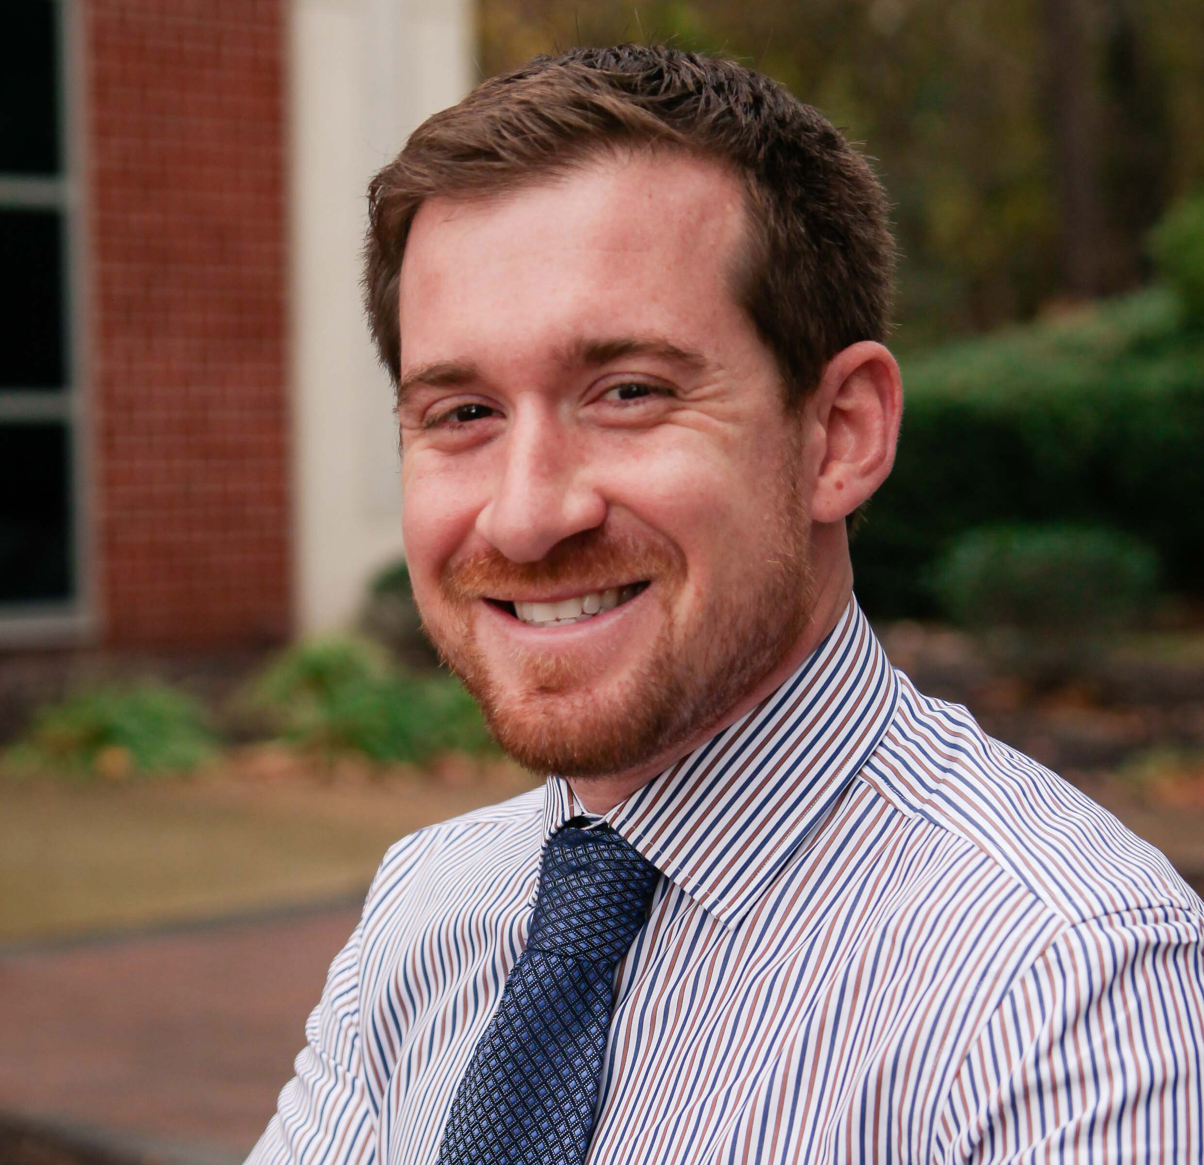

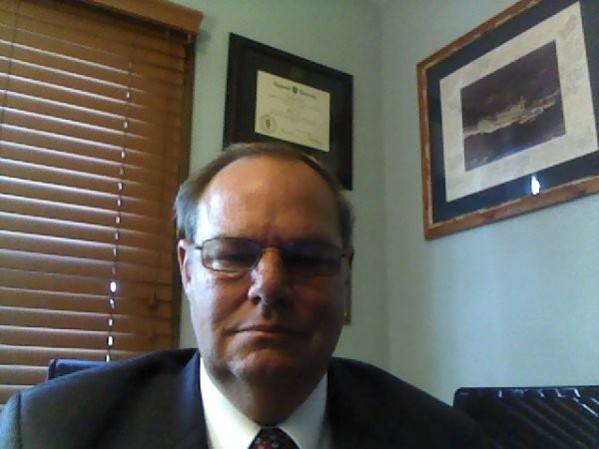
NMO, NBAC, & NTAC TSC Co-Chairs & OASIS Maintainers
TSC | Approved (TSC CHAIRS)
NMO TSC | Ms. Darcy Staley & Ms. Beth Smalley
NBAC TSC | Mr. Kamran Atri & Mr. Thomas Krul, Mr. Paul Wormeli
NTAC TSC | Dr. Scott Renner & Mr. Brad Bolliger
GitHub Repos | Primary | Alternates
NIEM Open | Ms. Christina Medlin, Mr. Aubrey Beach | Mr. Tom Carlson, Ms. Shunda Louis, Mr. Steve Sullivan (pgb-minutes)
NTAC-Admin | Dr. Scott Renner, Mr. Brad Bolliger | Mr. Aubrey Beach, Mr. Tom Carlson, Mr. Jim Cabral, Ms. Christina Medlin, Ms. Shunda Louis
NBAC-Admin | Mr. Steve Sullivan, Mr. Aubrey Beach | Ms. Shunda Louis, Ms. Christina Medlin
NMO-Admin | Ms. Darcy Staley, Mr. Aubrey Beach | Mr. Steve Sullivan, Ms. Shunda Louis
NTAC TSC
NBAC TSC
NMO
TSC
Christina Medlin
Aubrey Beach
Dr. Scott Renner
Brad Bolliger
Steve Sullivan
Darcy Staley

Slide 8








Resources
Follow Us On Twitter
https://twitter.com/NIEMconnects?ref_src=twsrc%5Etfw
Katherine Escobar, katherine.b.escobar.civ@mail.mil, 757-203-8631
Git Repos
NIEMOpen: https://github.com/niemopen/
NTAC TSC
https://github.com/niemopen/ntac-admin
NBAC TSC
https://github.com/niemopen/nbac-admin
NMO TSC
https://github.com/niemopen/nmo-admin
NIEMOpen Slack Channel: https://niemopen.slack.com/
Mailing Lists
NIEMOpen: https://lists.oasis-open-projects.org/g/niemopen
PGB: https://lists.oasis-open-projects.org/g/niemopen-pgb
NTAC TSC: https://lists.oasis-open-projects.org/g/niemopen-ntactsc
NBAC TSC: https://lists.oasis-open-projects.org/g/niemopen-nbactsc
NMO TSC: https://lists.oasis-open-projects.org/g/niemopen-nmotsc
https://www.niem.gov/
https://niemopen.org/
https://www.linkedin.com/groups/1903175/profile
https://www.youtube.com/channel/UCg9qV22PXLBjG41hc-EwVrQ
IEPD/MEP REPO
MEP TOOL
CMF TOOL
NDR v6.0 PSD01
NIEM Model v6.0 PS02

Slide 9
backup

Slide 10

PGB EXPERT VOTING MEMBERS &
NON-VOTING MEMBERS
PGB EXPERT VOTING MEMBERS
Technical Steering Committees
PGB EXPERT NON-VOTING MEMBERS
Technical Steering Committees
Mr. Brad Bolliger
Co-Chair, NIEM Technical Architecture Committee TSC
Mr. Thomas Krul
Co-Chair, NIEM Business Architecture Committee TSC
Ms. Beth Smalley
Co-Chair, NIEM Management Office TSC
Dr. Scott Renner
Co-Chair, NIEM Technical Architecture Committee TSC
Mr. Kamran Atri
Co-Chair, NIEM Business Architecture Committee TSC
Notes:
Open Project Rules - OASIS Open (oasis-open.org)
5.1 Overall guidance for the Project is provided by its Project Governing Board (or PGB). The PGB is composed of one voting member from each Project Sponsor who elects to appoint a PGB member, and (a) if the PGB has one or more Technical Steering Committees, one voting expert representative from each TSC, elected or appointed by that TSC, or (b) otherwise, the PGB may appoint at least one and no more than two voting expert representatives from its community of contributors. The PGB may create additional non-voting PGB member seats for expert representatives to be elected by the TSC or appointed by the PGB. The PGB membership of all such members of any type is conditioned on satisfaction of the CLA requirement of Section 5.2. Voting status on the PGB may be affected by the provisions of Section 5.7.

